Slide 1

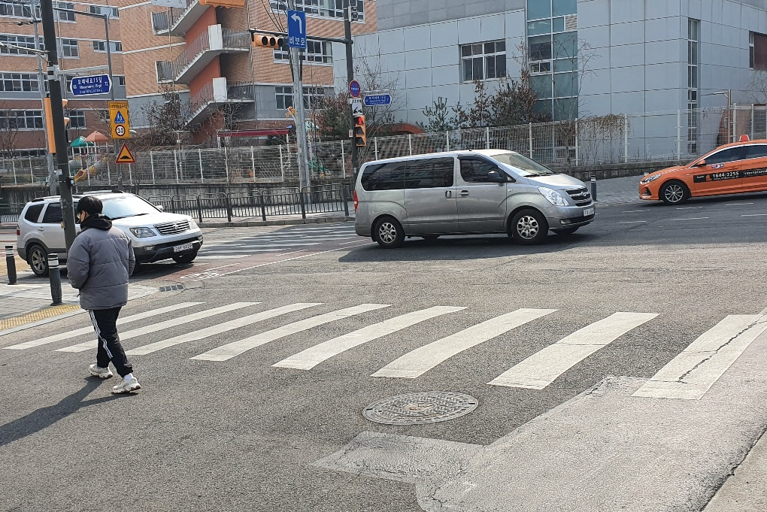


Mask R-CNN
CNN
Predict
state of the object
User
Direct designation
Stage 1 : 데이터 만들기
Stage 2 : 테스트

Slide 2

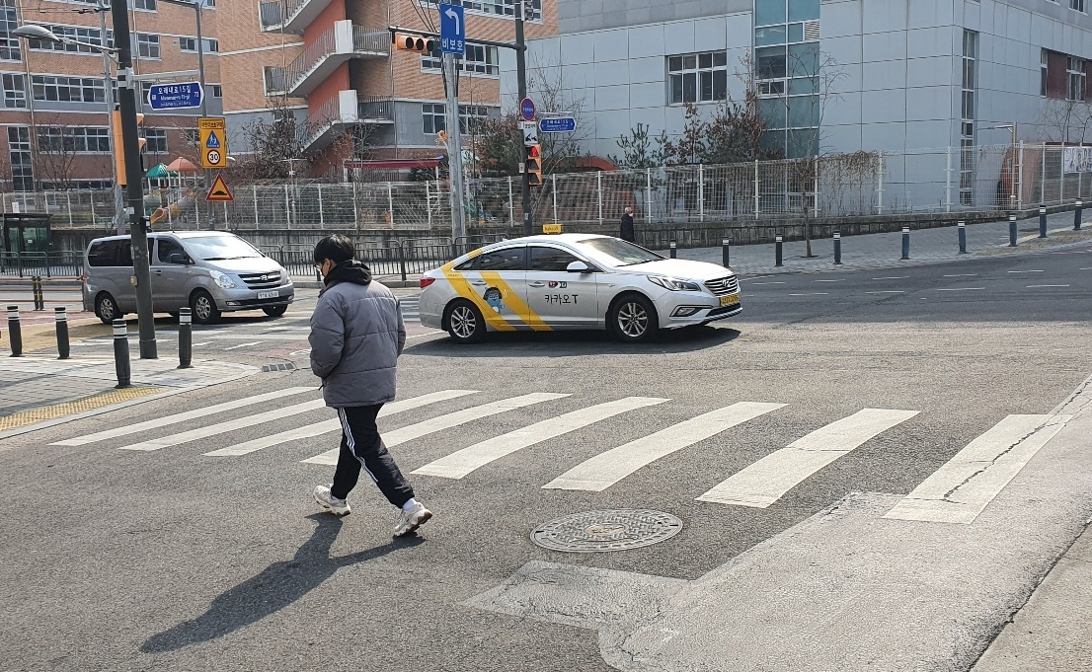
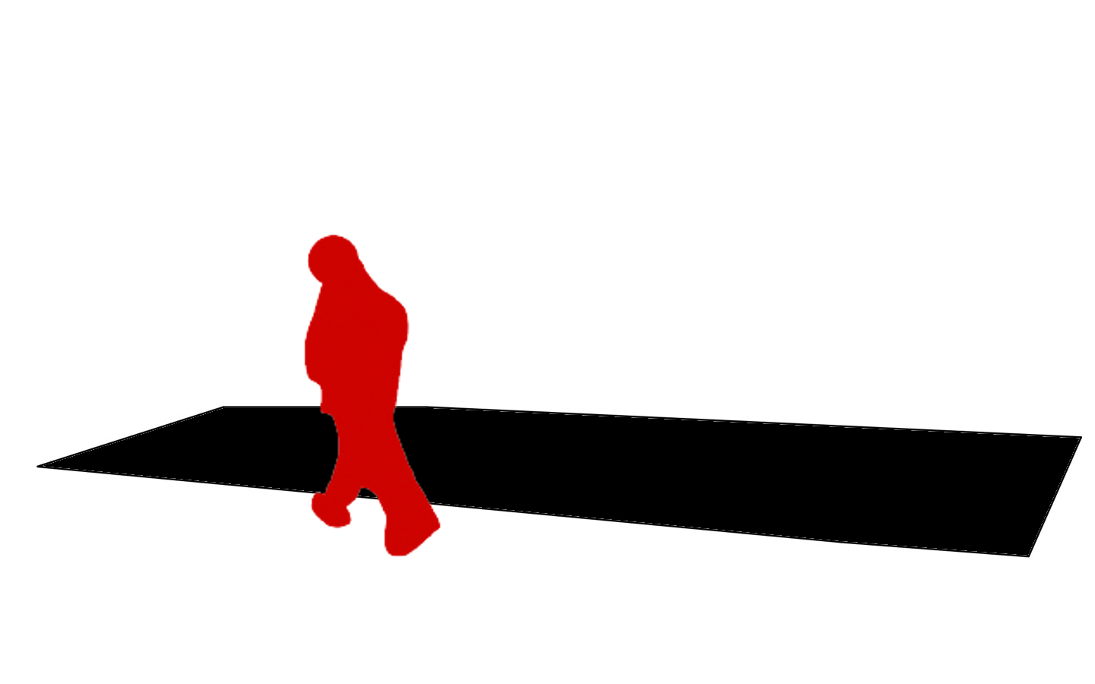
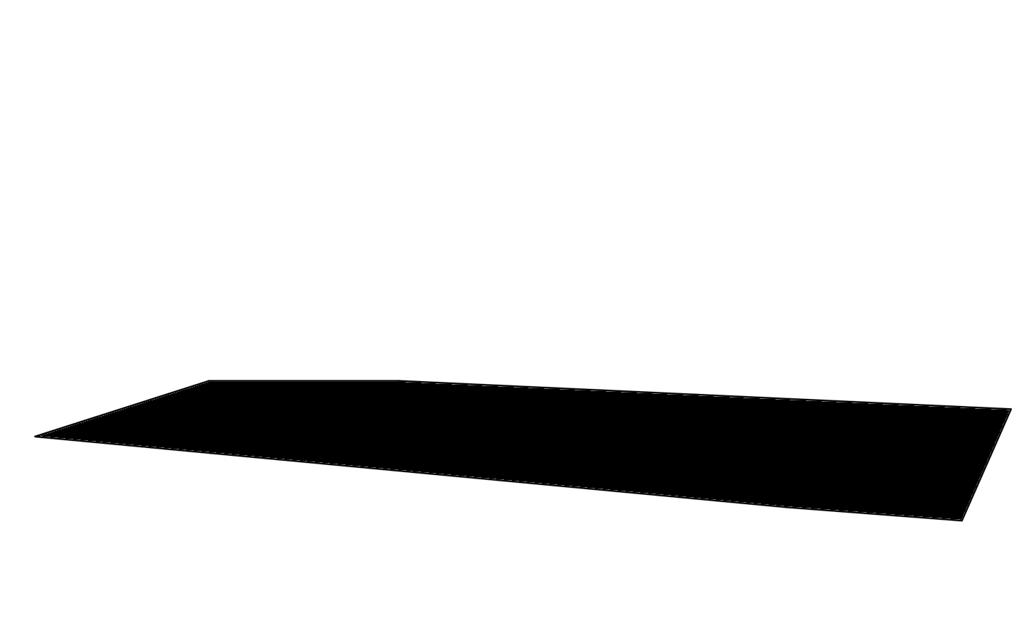
Learning Data :
Test Data :
Mask R-CNN
CNN Model
for Prediction
Object Mask Image
Normal Image
User
Direct designation
Composite Image
Predict
state of the object
Crosswalk Area Image
Stage 1 : 데이터 만들기
Stage 2 : 학습
Stage 3 : 테스트

Slide 3
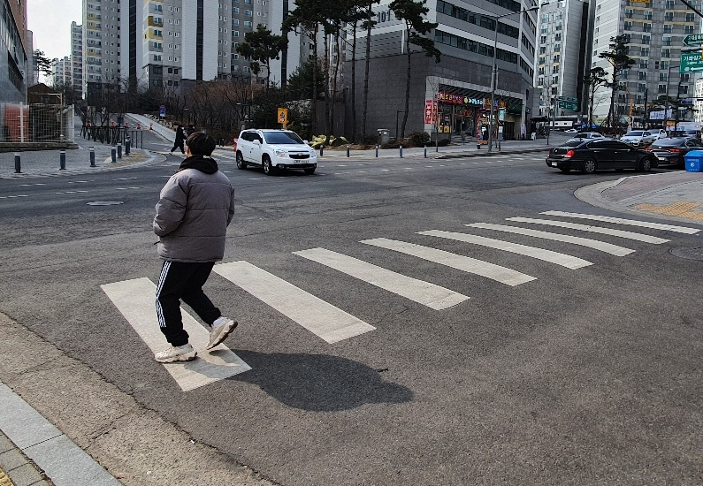
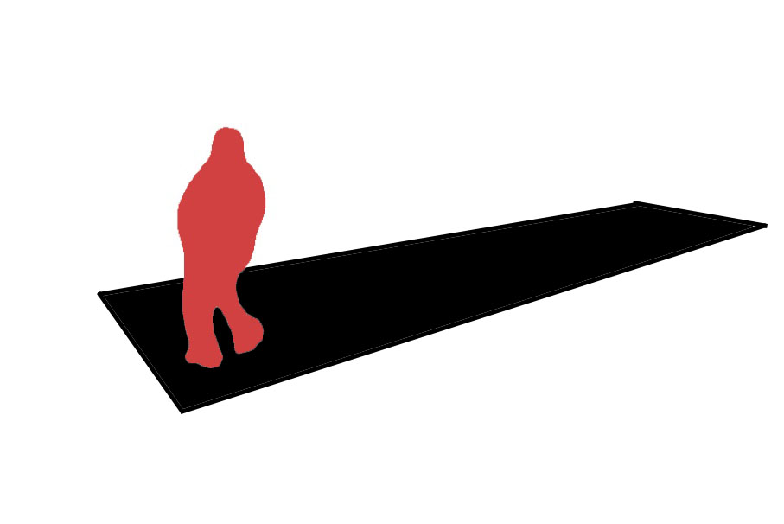
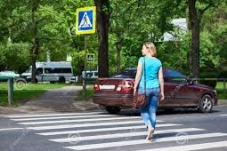
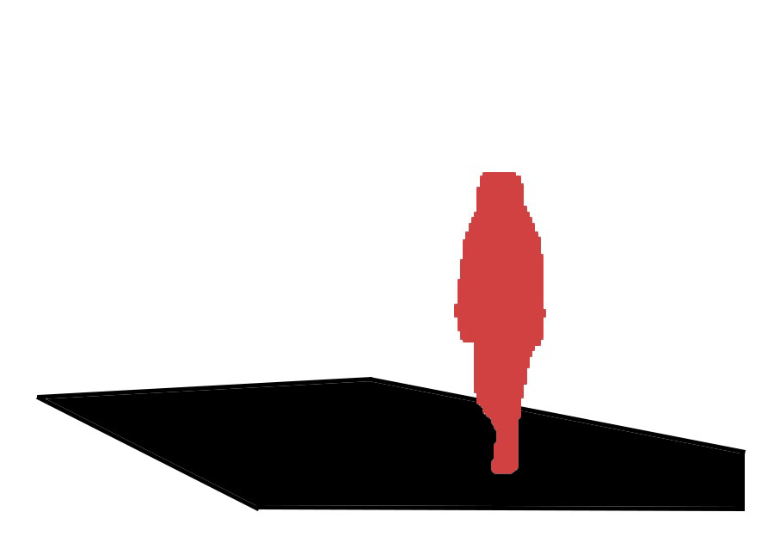
Training
CNN Model
Mask R-CNN
Mask R-CNN
Test
Safety
Danger
Original Images
Masked Images
Data stage
Training & Test stage

Slide 4


Training
CNN Model
Mask R-CNN
Test
Safety
Danger
Original Images
Masked Images

Slide 5













Augmentation
Augmentation

Slide 6
Mask R-CNN
Training
CNN Model
Safety
Danger
Original Images
Masked Images

Slide 7
Mask R-CNN
Training
CNN
Crosswalk Detection Algorithm
Mask R-CNN
+
Crosswalk Detection Algorithm
Validation
Danger
Safety

